Slide 1


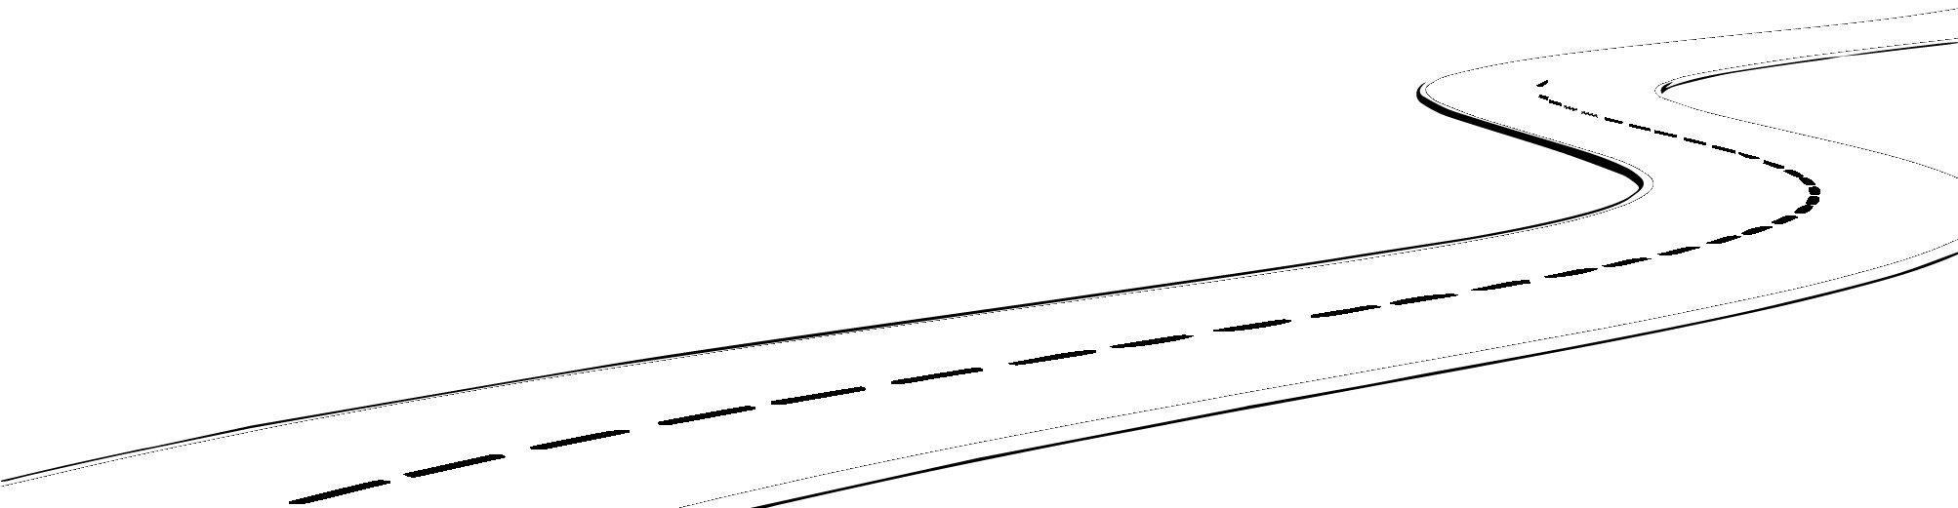
Cloud HPC at AWS
Dr. Jeffrey Layton, Principal Architect - HPC
November, 2015

Slide 2
Research Computing

Slide 3
How is AWS used for Scientific Computing?
HPC for Engineering and Simulation
High Throughput Computing (HTC) for Data Intensive Analytics
Hybrid Supercomputing Centers
Collaborative Research Environments
Citizen Science
Science-as-a-Service
Machine Learning

Slide 4
Why do researchers love using AWS?
Time to Science
Access to research infrastructure in minutes
Low Cost
Pay as you go computing
Elastic
Easily add or remove capacity
Globally Accessible
Easily Collaborate with researchers around the world
Secure
A collection of tools to protect data and privacy
Scalable
Access to effectively limitless capacity

Slide 5
Why does AWS care about Scientific Computing?
We want to improve our world by accelerating the pace of scientific discovery
It is a great application of AWS with a broad customer base
The scientific community helps us innovate on behalf of all customers
Streaming data processing and analytics
Exabyte scale data management solutions and exaflop scale computing
Collaborative research tools and techniques
New AWS regions
Significant advances in low-power compute, storage, and data centers
Efficiencies which lower our costs and therefore pricing for all customers

Slide 6



Peering with all global research networks
Internet2
aarnet
GEANT
Sinet
ESnet
Pacific Gigapop

Slide 7




Public Datasets
Landsat
NEX
1000 Genomes Project
Human Microbiome Project

Slide 8
HPC

Slide 9

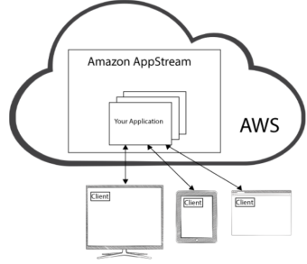
Why Cloud for HPC?
Scalability
If you need to run on lots of nodes, just spin them up
If you don’t need nodes, turn them off (and don’t pay for them)
Time to Research
Usually on-prem HPC resources are centralized (shared)
Researchers like to have their own nodes when they need them
World-Wide Collaboration
Share data via the cloud
Latest Technology
Can save $$$
Different kinds of nodes (instances)

Slide 10
HPC Architectures

Slide 11

AWS HPC Architecture – Phases of Deployment
You must think in “cloud”
You cannot think in “on-prem” and transpose
You must think in “cloud”
Do you think you can do that Mr. Gant?
Fork lift
Make it look like on-premise
Cloud “port”
Adapt to cloud features
Autoscaling
Spot
Born in the Cloud
Rethink application

Slide 12
AWS HPC Architecture
On-Premise
AWS Cloud
Master Node
Master Instance
Compute Node
Compute Node
Compute Instance
Compute Instance
Compute Instance
Compute Node
Compute Node
Compute Instance
Compute Instance
Compute Instance
Storage
(NFS, Parallel)
Storage
(NFS, Parallel)

Slide 13
Architecture points
Why be limited to the number of nodes in your on-prem cluster?
Cloud allows to scale up and down as needed
Why limit yourself to a “single” cluster for all users?
Why not give each user their own cluster?
They can scale up and down as needed
Leave your data in the cloud
Compute on it as needed
Share it as needed
Life cycle control
Visualization

Slide 14
Queues

Slide 15
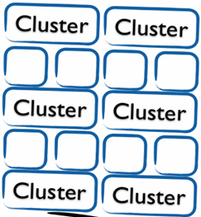





The Hidden Cost of Queues
Conflicting goals
HPC users seek fastest possible time-to-results
Simulations are not steady-state workloads
IT support team seeks highest possible utilization
Result:
The job queue becomes the capacity buffer
Job completion times are hard to predict
Users are frustrated and run fewer jobs
?

Slide 16
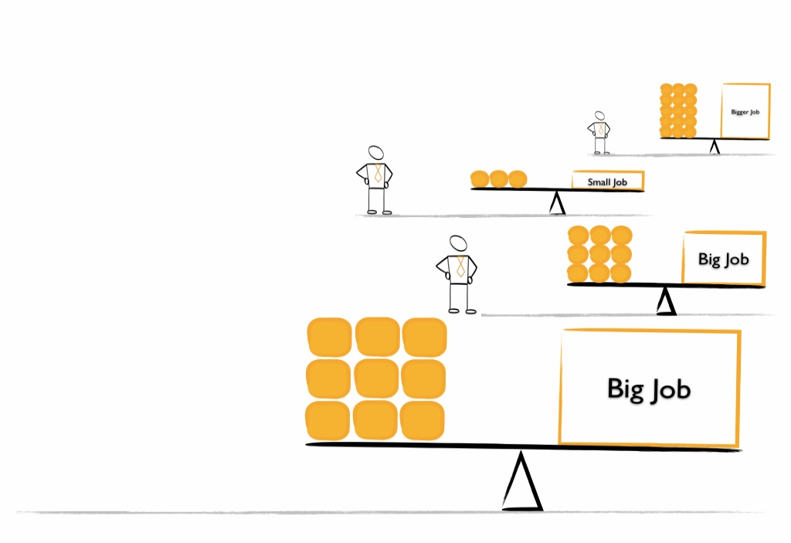

On AWS, deploy multiple clusters running at the same time and match the architectures to the jobs

Slide 17
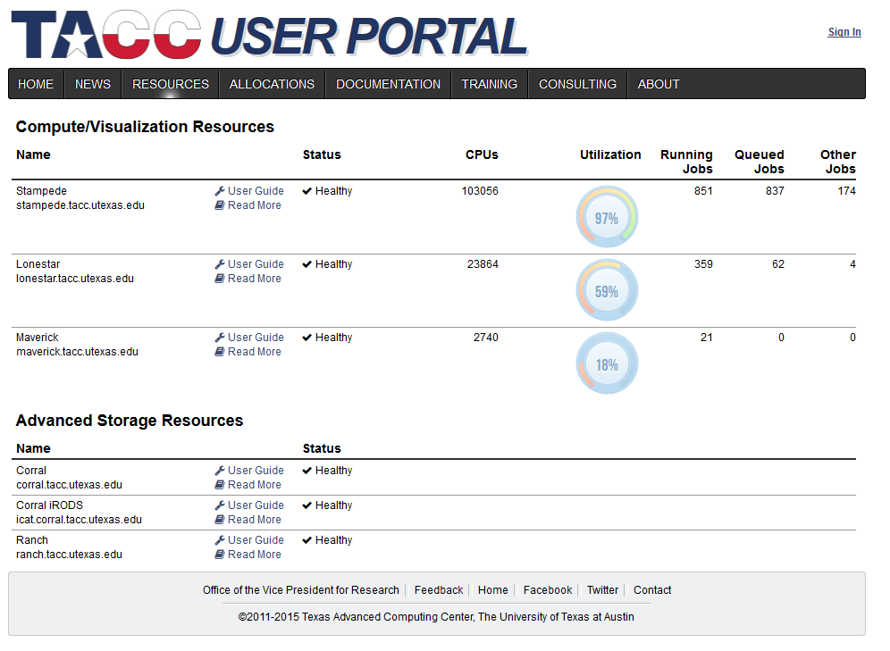
Example: TACC Portal – 4/6/2015
Need capacity
Too much capacity
Too much capacity

Slide 18
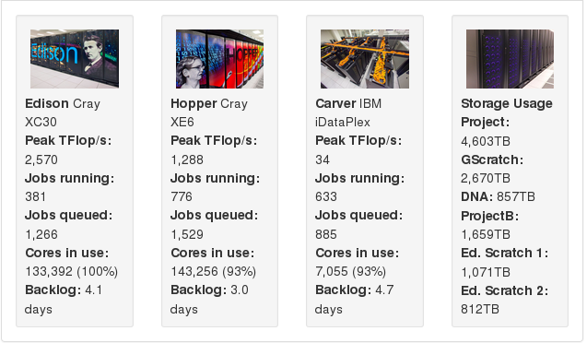
Example: NERSC Portal – 4/30/2015
Edison – 4:1 backlog
Hopper – 2:1 backlog
Carver – 1.5:1 backlog
Need more capacity!!

Slide 19
Other Stats:
XSEDE:
In 2012, ~32% of jobs only used 1 core
72% of all jobs used 16 cores or less (single c4 instance)
ECMWF (European weather forecasting)
82% of all jobs are either single node or single-core

Slide 20
Spot is the Bomb!

Slide 21


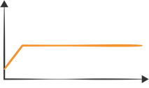
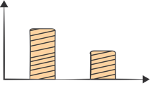
Multiple Pricing Models
Free Tier
Get Started on AWS with free usage & no commitment
For POCs and getting started
On-Demand
Pay for compute capacity by the hour with no long-term commitments
For spiky workloads, or to define needs
Reserved
Make a low, one-time payment and receive a significant discount on the hourly charge
For committed utilization
Spot
Bid for unused capacity, charged at a Spot Price which fluctuates based on supply and demand For time-insensitive or transient workloads
AWS Spot is a
game-changer
for HPC

Slide 22
Quick Spot Comparison:
Compare Most Expensive “Spot” to least expensive “On-demand”
Master Node:
c4.8xlarge
2x gp2 1TB EBS volumes
On-Demand
us-east - $1.856/hour
us-west-1 - $2.208/hour
Compute Nodes
c4.8xlarge
On-demand us-east - $1.856/hour
Spot (us-west-1) - $0.28/hour

Slide 23
Spot vs. On-Demand
4 compute nodes, 2 hours
16 compute nodes, 32 hours
On-Demand, us-east
$19.13
Spot (us-west-1)
$7.22
Ratio: 2.64
On-Demand, us-east
$1,018.77
Spot (us-west-1)
$223.11
Ratio: 4.57

Slide 24
Cluster Tools

Slide 25
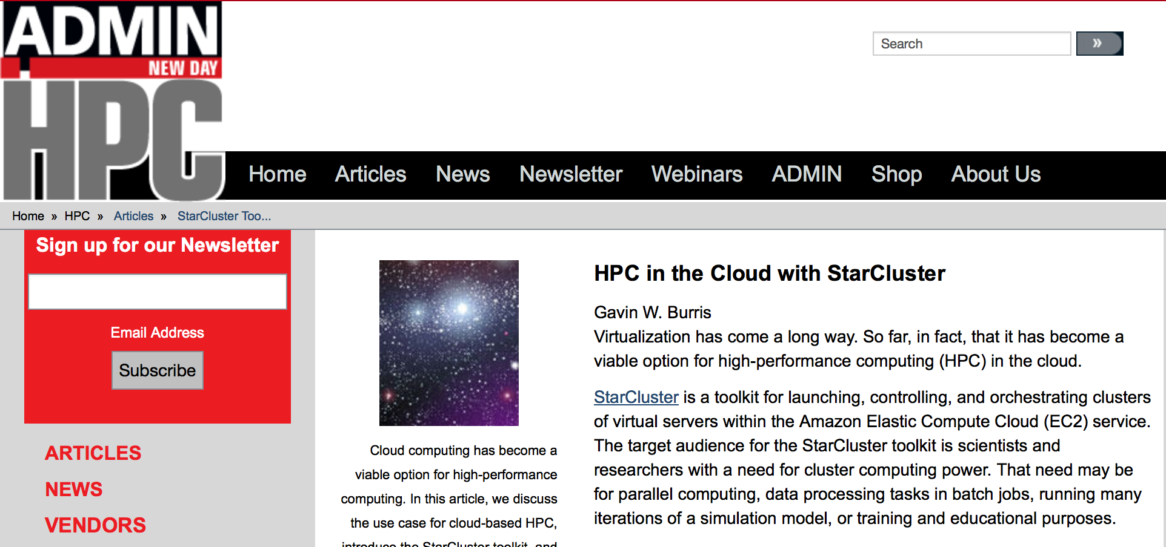
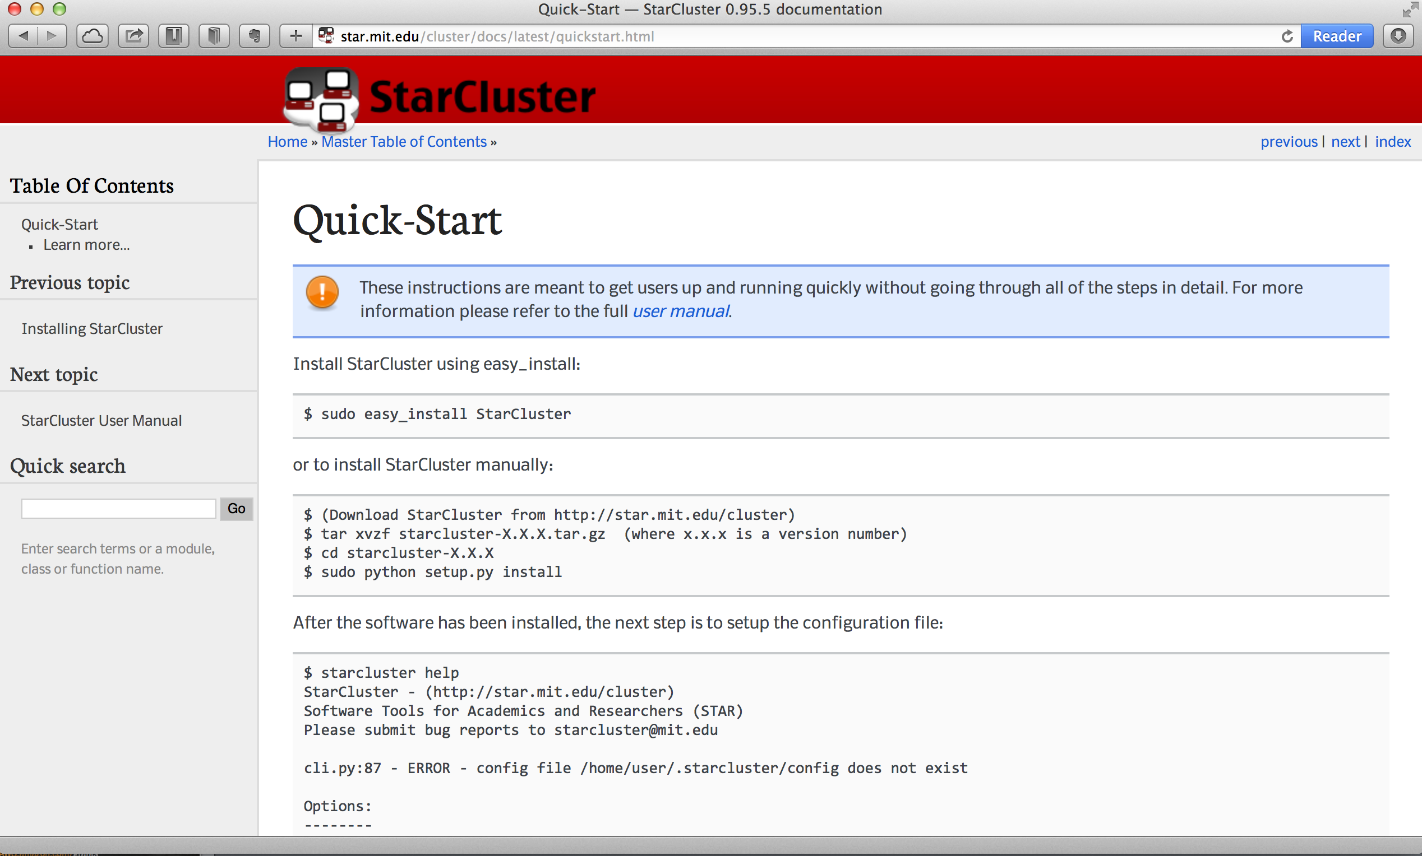

MIT STARcluster - an HPC cluster in minutes
StarCluster is a utility for creating and managing distributed computing clusters hosted on Amazon's Elastic Compute Cloud.
It uses Amazon's EC2 API to create and destroy clusters of Linux virtual machines on demand. It’s an easy-to-use and extensible cluster computing toolkit for the cloud.
http://bit.ly/starclusterArticle
http://star.mit.edu/cluster/
15 minutes

Slide 26
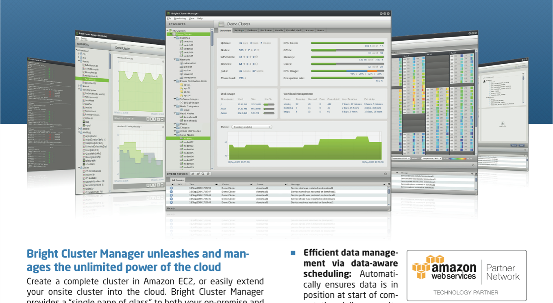
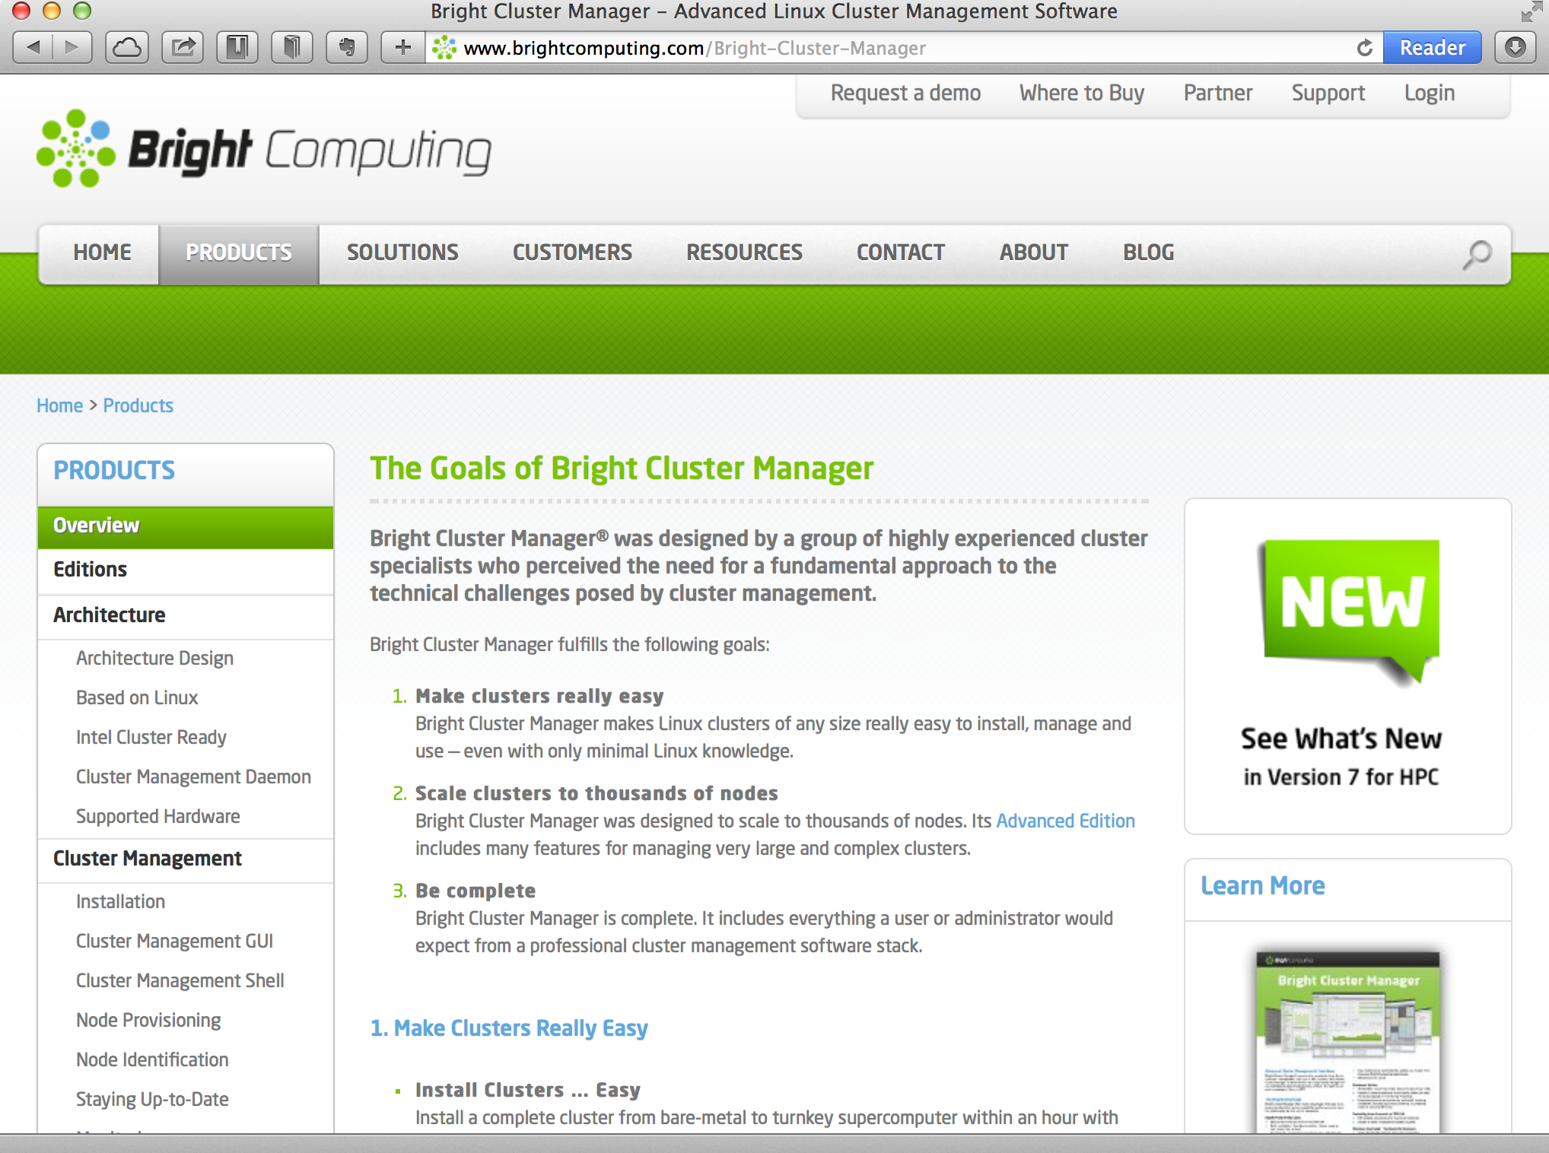
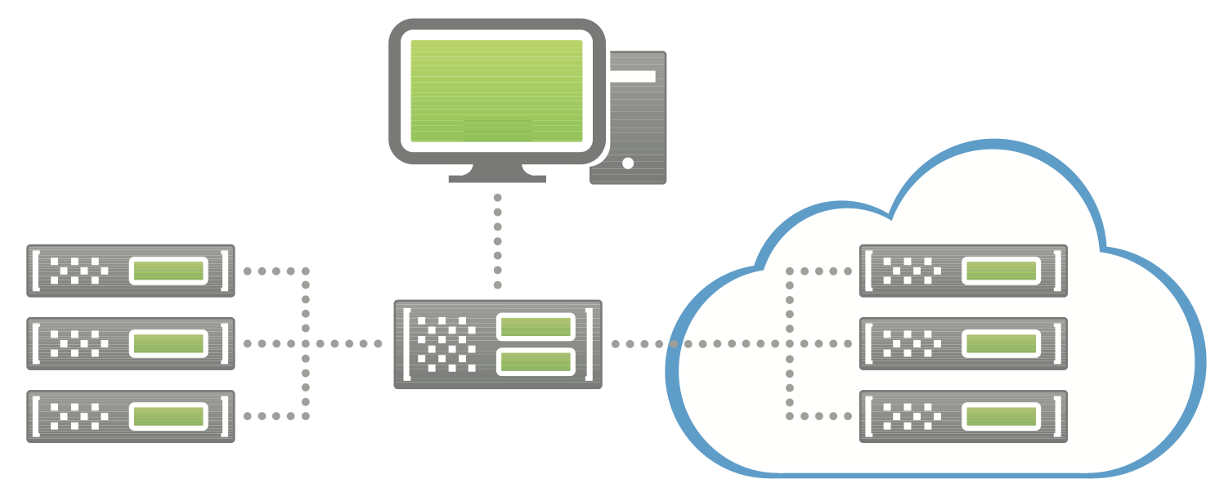
Bright Cluster Manager
Bright cluster manager is an established very popular HPC cluster management platform that can simultaneously manage both on-premises clusters as well as infrastructure in the cloud - all using the same system images.
http://www.brightcomputing.com
Bright has offices in the UK, Netherlands (HQ) and US.

Slide 27
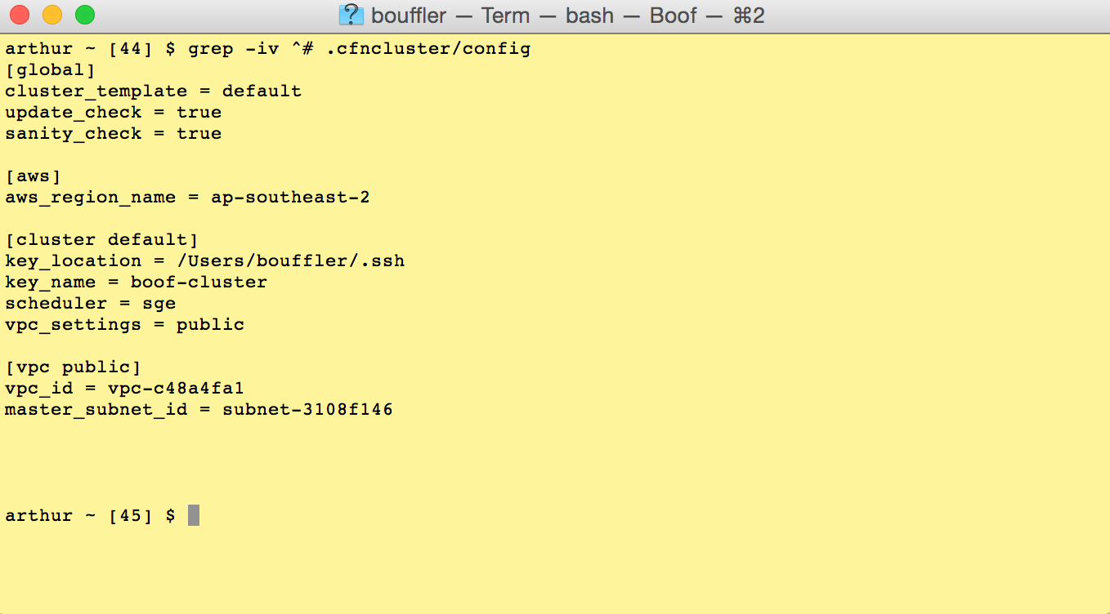
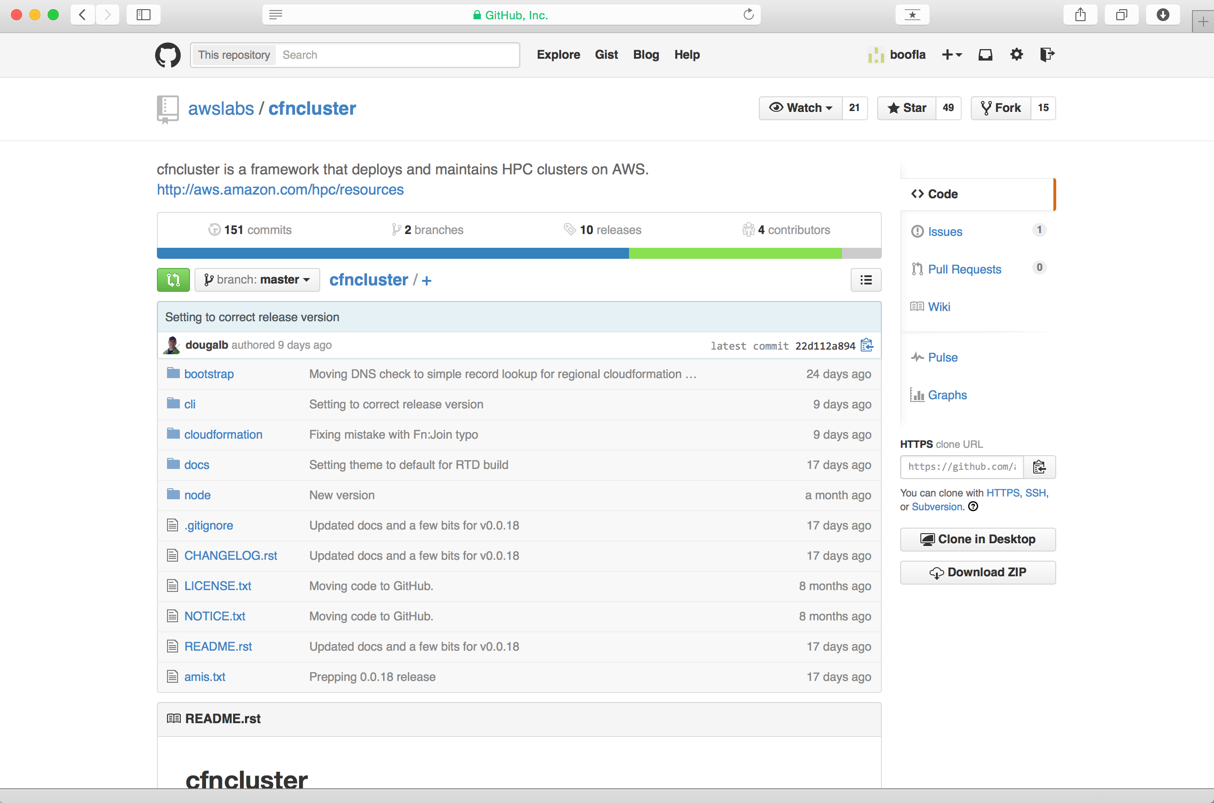

cfnCluster - provision an HPC cluster in minutes
cfncluster is a sample code framework that deploys and maintains clusters on AWS. It is reasonably agnostic to what the cluster is for and can easily be extended to support different frameworks. The CLI is stateless, everything is done using CloudFormation or resources within AWS.
#cfncluster
https://github.com/awslabs/cfncluster
10 minutes

Slide 28
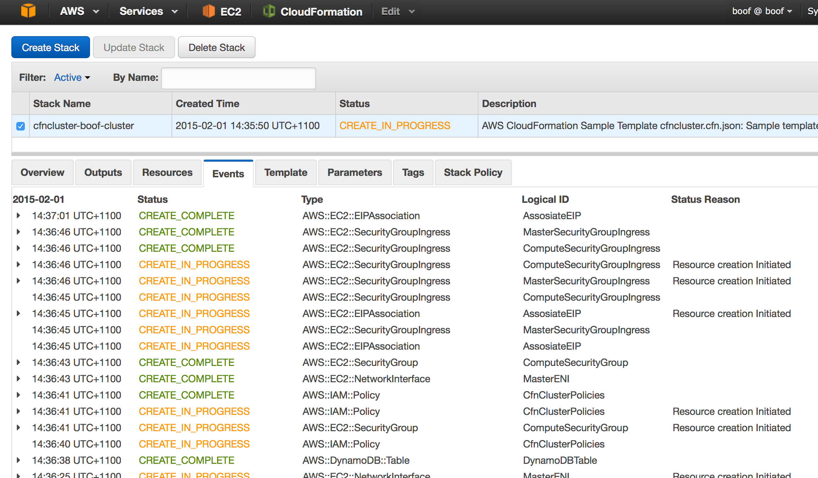
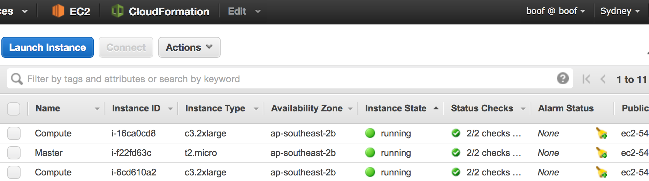
Infrastructure as code
$ cfnCluster create boof-cluster
Starting: boof-cluster
Status: cfncluster-boof-cluster - CREATE_COMPLETE Output:"MasterPrivateIP"="10.0.0.17"
Output:"MasterPublicIP"="54.66.174.113"
Output:"GangliaPrivateURL"="http://10.0.0.17/ganglia/"
Output:"GangliaPublicURL"="http://54.66.174.113/ganglia/"
The creation process might take a few minutes (maybe up to 5 mins or so, depending on how you configured it.
Because the API to Cloud Formation (the service that does all the orchestration) is asynchronous, we can kill the terminal session if we wanted to and watch the whole show from the AWS console (where you’ll find it all under the “Cloud Formation”dashboard in the events tab for this stack.
#cfncluster

Slide 29
Yes, it’s a real HPC cluster
[ec2-user@ip-10-0-0-17 ~]$ ed hw.qsub
hw.qsub: No such file or directory
a
#!/bin/bash
#
#$ -cwd
#$ -j y
#$ -pe mpi 2
#$ -S /bin/bash
#
module load openmpi-x86_64
mpirun -np 2 hostname
.
w
110
q
[ec2-user@ip-10-0-0-17 ~]$ ll
total 4
-rw-rw-r-- 1 ec2-user ec2-user 110 Feb 1 05:57 hw.qsub
[ec2-user@ip-10-0-0-17 ~]$ qsub hw.qsub
Your job 1 ("hw.qsub") has been submitted
[ec2-user@ip-10-0-0-17 ~]$
[ec2-user@ip-10-0-0-17 ~]$ qstat
job-ID prior name user state submit/start at queue slots ja-task-ID
------------------------------------------------------------------------------------------------
1 0.55500 hw.qsub ec2-user r 02/01/2015 05:57:25 all.q@ip-10-0-0-44.ap-southeas 2
[ec2-user@ip-10-0-0-17 ~]$ qstat
[ec2-user@ip-10-0-0-17 ~]$ ls -l
total 8
-rw-rw-r-- 1 ec2-user ec2-user 110 Feb 1 05:57 hw.qsub
-rw-r--r-- 1 ec2-user ec2-user 26 Feb 1 05:57 hw.qsub.o1
[ec2-user@ip-10-0-0-17 ~]$ cat hw.qsub.o1
ip-10-0-0-136
ip-10-0-0-154
[ec2-user@ip-10-0-0-17 ~]$
arthur ~ [26] $ cfnCluster create boof-cluster
Starting: boof-cluster
Status: cfncluster-boof-cluster - CREATE_COMPLETE Output:"MasterPrivateIP"="10.0.0.17"
Output:"MasterPublicIP"="54.66.174.113"
Output:"GangliaPrivateURL"="http://10.0.0.17/ganglia/"
Output:"GangliaPublicURL"="http://54.66.174.113/ganglia/"
arthur ~ [27] $ ssh ec2-user@54.66.174.113
The authenticity of host '54.66.174.113 (54.66.174.113)' can't be established.
RSA key fingerprint is 45:3e:17:76:1d:01:13:d8:d4:40:1a:74:91:77:73:31.
Are you sure you want to continue connecting (yes/no)? yes
Warning: Permanently added '54.66.174.113' (RSA) to the list of known hosts.
[ec2-user@ip-10-0-0-17 ~]$ df
Filesystem 1K-blocks Used Available Use% Mounted on
/dev/xvda1 10185764 7022736 2639040 73% /
tmpfs 509312 0 509312 0% /dev/shm
/dev/xvdf 20961280 32928 20928352 1% /shared
[ec2-user@ip-10-0-0-17 ~]$ qhost
HOSTNAME ARCH NCPU NSOC NCOR NTHR LOAD MEMTOT MEMUSE SWAPTO SWAPUS
----------------------------------------------------------------------------------------------
global - - - - - - - - - -
ip-10-0-0-136 lx-amd64 8 1 4 8 - 14.6G - 1024.0M -
ip-10-0-0-154 lx-amd64 8 1 4 8 - 14.6G - 1024.0M -
[ec2-user@ip-10-0-0-17 ~]$ qstat
[ec2-user@ip-10-0-0-17 ~]$
Now you have a cluster, probably running CentOS 6.x, with Sun Grid Engine as a default scheduler, and openMPI and a bunch of other stuff installed. You also have a shared filesystem in /shared and an autoscaling group ready to expand the number of compute nodes in the cluster when the existing ones get busy.
You can customize quite a lot via the .cfncluster/config file - check out the comments.
#cfncluster

Slide 30
System-wide Upgrade from Ivy Bridge to Haswell
$ ed ~/.cfncluster/config
/compute_instance_type/
compute_instance_type = c3.8xLarge
s/c3/c4/p
compute_instance_type = c4.8xLarge
w
949
$ cfncluster update boof-cluster
Yes, really :-)
Downgrading is just as easy. Honest.
#cfncluster

Slide 31







Config options to explore …
Many options, but the most interesting ones immediately are:
t2.micro is tiny
c3.4xlarge might be more interesting …
# (defaults to t2.micro for default template)
compute_instance_type = t2.micro
# Master Server EC2 instance type
# (defaults to t2.micro for default template
#master_instance_type = t2.micro
# Inital number of EC2 instances to launch as compute nodes in the cluster.
# (defaults to 2 for default template)
#initial_queue_size = 1
# Maximum number of EC2 instances that can be launched in the cluster.
# (defaults to 10 for the default template)
#max_queue_size = 10
# Boolean flag to set autoscaling group to maintain initial size and scale back
# (defaults to false for the default template)
#maintain_initial_size = true
# Cluster scheduler
# (defaults to sge for the default template)
scheduler = sge
# Type of cluster to launch i.e. ondemand or spot
# (defaults to ondemand for the default template)
#cluster_type = ondemand
# Spot price for the ComputeFleet
#spot_price = 0.00
# Cluster placement group. This placement group must already exist.
# (defaults to NONE for the default template)
#placement_group = NONE
Min & Max size of your cluster.
Whether to fall back when things get quiet
Also can use ‘openlava’ or ‘torque’
Explore the SPOT market if you want to save money :-)
A placement group will provision your instances very close to each other on the network.
#cfncluster

Slide 32
Notable HPC Examples

Slide 33
In 2013
C3 Instance Cluster*
484 TFLOPS
Making it the 64th fastest supercomputer in the world
*Representing a tiny fraction of total AWS compute capacity

Slide 34
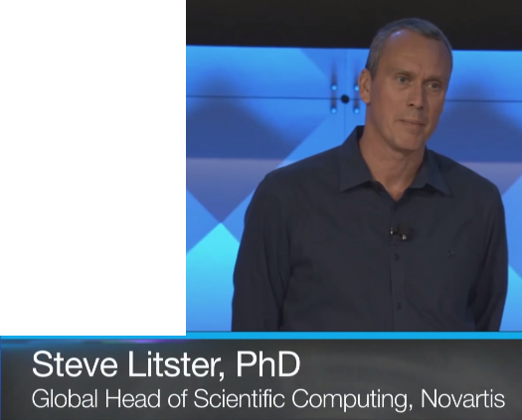
Accelerating Science
The Problem for Cancer Drug Design:
Cancer researcher needed 50,000 cores, (not available in-house)
The options they didn’t choose:
Buy infrastructure: Spend Millions, wait 6 months
Spend months writing software
“We contacted our friends at Cycle Computing, AWS, … to create a system that was fast, extremely secure, … inexpensive, and easy to use.”

Slide 35
Final Solution:
3 new compounds
40 years of computing
10,466 servers World-Wide
$44M cluster for 8 hours for $4,362
Multiple AZ’s
Multiple Regions
Automated bidding
Optimized orchestration

Slide 36

University of Southern California
USC Chemistry Professor Dr. Mark Thompson
“Solar energy has the potential to replace some of our dependence on fossil fuels, but only if the solar panels can be made very inexpensively and have reasonable to high efficiencies. Organic solar cells have this potential.”

Slide 37
Challenge:
Examine possible organic compounds for producing solar energy
Computational testing of 205,000 compounds
Requires 2,312,959 core-hours
(264 compute years)
$68M on-premise system

Slide 38
Solution:
CycleServer from Cycle Computing
16,788 Spot Instances
156,314 cores
Average of 9.3 cores per instance
1.21 PFLOPS (Rpeak)

Slide 39

Region Deployment
US-West-2
EU
US-East
Tokyo
US-West-1
Singapore
Brazil
Australia

Slide 40
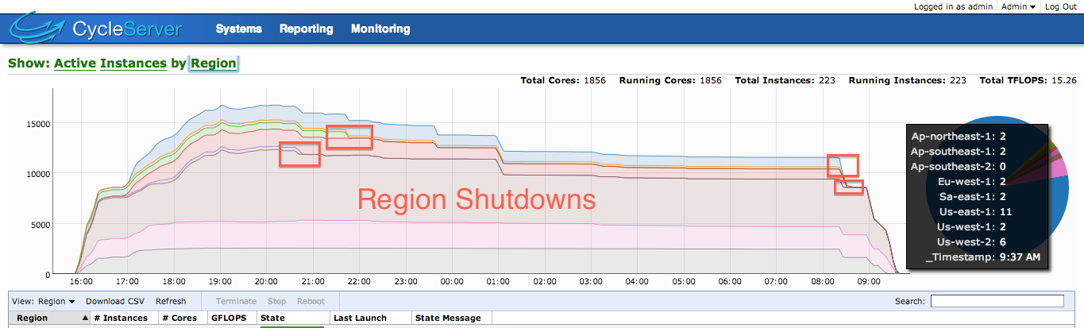
Resilient Workload Scheduling

Slide 41

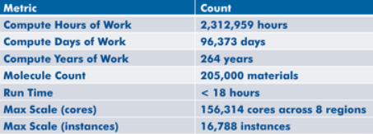
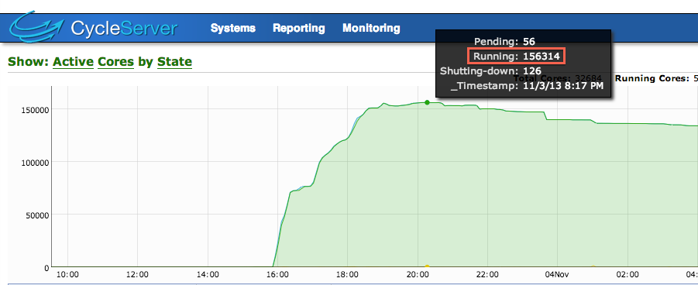
What Does Scale Mean in the Cloud?
18 hours 205,000 materials analyzed 156,314 AWS Spot cores at peak
2.3M core-hours
Total spending: $33K (Under 1.5 cents per core-hour)

Slide 42
Summary:
205,000 molecules
264 years of computing
Done in 18 hours on $68M system
Cost only $33,000

Slide 43


NASA Head in the Clouds Project
Project Goal
Using NGA data to estimate tree and bush biomass over the entire arid and semi-arid zone on the south side of the Sahara
Project Summary
Estimate carbon stored in trees and bushes in arid and semi-arid south Sahara
Establish carbon baseline for later research on expected CO2 uptake on the south side of the Sahar
Principal Investigators
Dr. Compton J. Tucker, NASA Goddard Space Flight Center
Dr. Paul Morin, University of Minnesota
Participants:
NASA GSFC, AWS, Intel

Slide 44
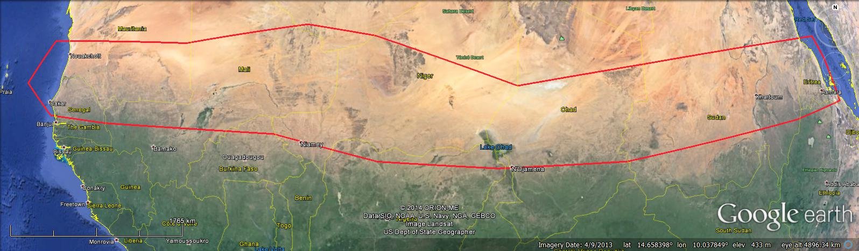
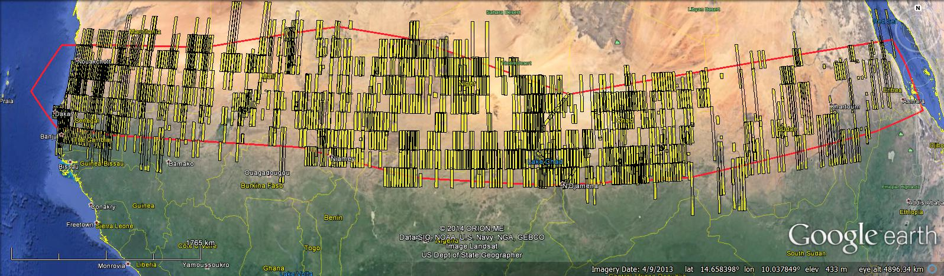
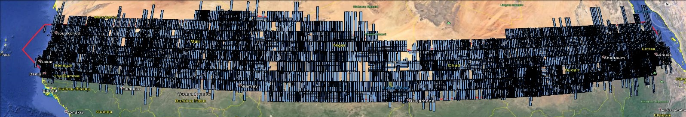

Existing Sub-Saharan Arid and Semi-arid Sub-meter Commercial Imagery
Area Of Interest (AOI) for Sub-Saharan Arid and Semi-arid Africa
~1600 strips (~20TB) at GSFC
9600 Strips (~80TB) to be delivered to GSFC

Slide 45
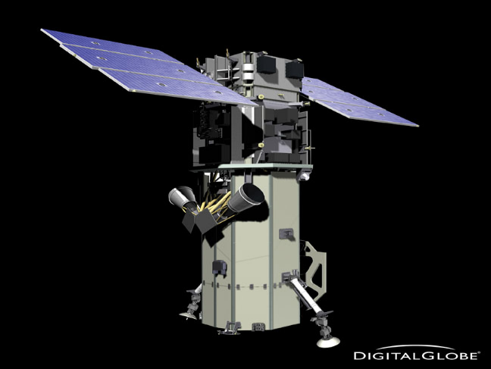
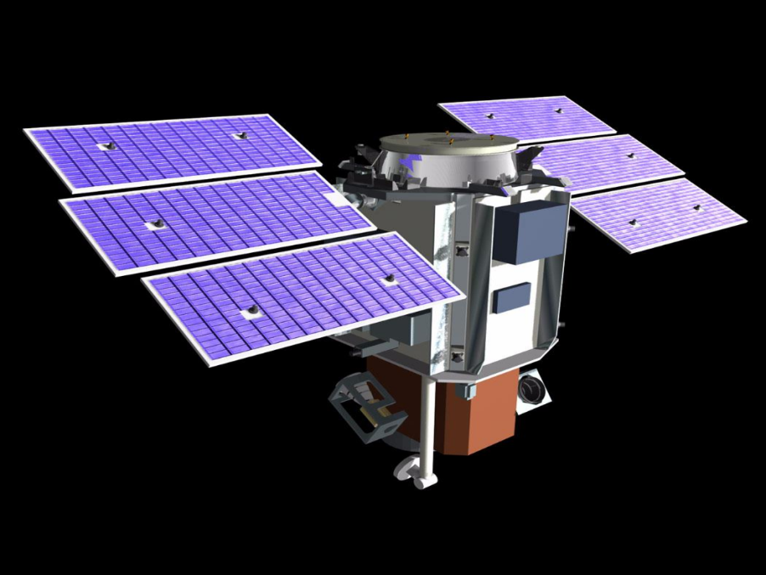
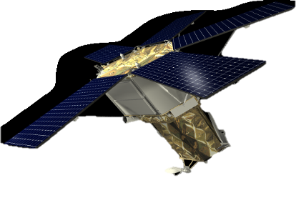
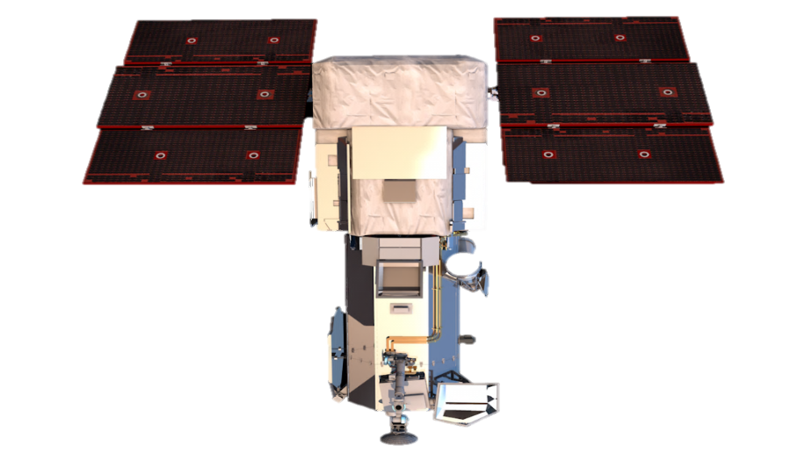
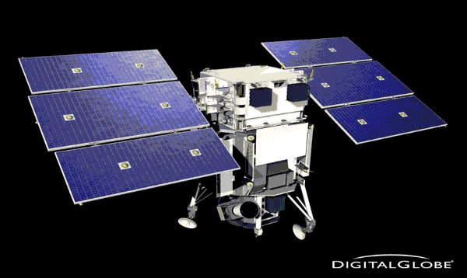
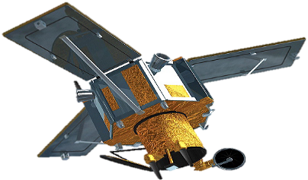
The DigtalGlobe Constellation
The Entire Archive is Licensed to the USG
Worldview 2
Geoeye
Quickbird
Ikonos
Worldview 3 (Available Q1 2015)
Worldview 1

Slide 46

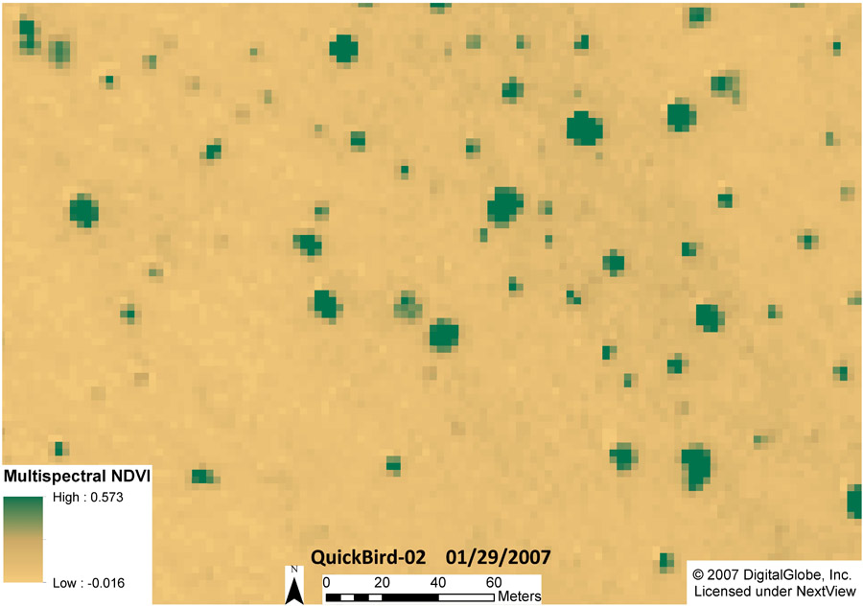
Panchromatic & Multi-spectral Mapping at the 40 & 50 cm scale

Slide 47
First Phase Results
Approximately 1/3 of data processed
200 Spot instances
6 hours of processing
Run in us-west-2 region
Carbon Neutral
“Helping the planet not harming it”
$80

Slide 48

Thank You
Agility

Slide 49
AWS pricing
Three ways to pay:
On-Demand
You can start an instance anytime you want
Most expensive
Reserved Instances
Can have a significant discount (up to 75%) compared to On-Demand
Reserved Instances provide you with a capacity reservation, so you can have confidence that you will be able to launch the instances you have reserved when you need them
Spot
Spot Instances enable you to bid for unused Amazon EC2 capacity
Instances are charged the Spot Price, which is set by Amazon EC2 and fluctuates periodically depending on the supply of and demand for Spot Instance capacity

